Slide 1
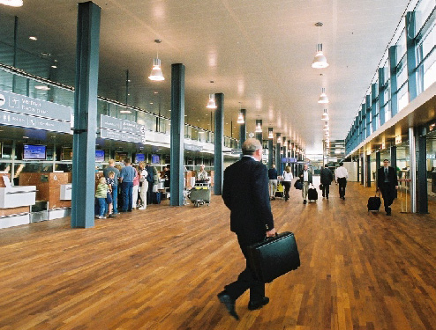


Modeling pedestrians in an airport scenario with a time-augmented Petri net
Djura Smits, Arnoud Visser and Frans Groen
12th International Conference on Intelligent Autonomous Systems Jeju Island, Korea, June, 2012
Universiteit van Amsterdam
Informatics Institute
Intelligent Systems Laboratory
Intelligent Autonomous Systems group
Notes:
Design of Perception, Modeling and Control Algorithms in a Simulated Testbed
To survive in an unstructured and dynamic environment, the perception, modeling & control loop has to be adaptive and to learn from experience. Inside the perception, this can be solved with pattern recognition algorithms. Models of the environment should allow inference about the state of the world and the consequences for the robot. Advanced control algorithms should not only consider the action space of a single robot, but make a deliberative decision in the joint action space of all robots in a rescue team.
Such advanced machine learning techniques typically need extensive training. A realistic simulation environment is a requisite to develop the algorithm and to test it in controlled circumstances. After this development the algorithm can be ported to the real robotic world. The potential of this approach is demonstrated with the use of mobile robots for search and rescue missions after a disaster. During rescue operations for disaster mitigation, cooperation is a must. This requirement is due to the structural diversity of disaster areas, variety of evidence of human presence that sensors can perceive, and the necessity to quickly and reliably examine targeted regions.
The talk will focus on the progress recently made in the Virtual Rescue competition, especially by the students and researchers of the Amsterdam Oxford Joint Rescue Forces

Slide 2
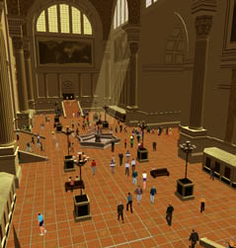
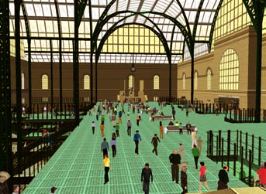
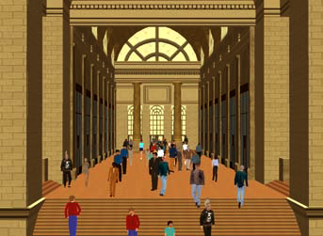
Context
Screenshots of a large-scale simulation of a virtual train station populated by self-animated virtual humans (Courtesy Shao & Terzopoulos [1])
Simulation of crowds with persons as reactive actors is done before, but modeling them as intelligent characters that can reason and plan their actions is still an open issue.
[1] Shao & Terzopoulos, ‘Autonomous pedestrians’, Proceedings of the 2005 ACM SIGGRAPH/Eurographics symposium on Computer animation, p. 19-28

Slide 3
Interesting Behaviors
Next to pure navigation behaviors, other occur:
Select an unoccupied seat and sit down
Approach a performance and watch
Meet with friends and chat
Queue at a vending machine and make a purchase
Queue at ticketing areas and purchase a ticket
[1] Shao & Terzopoulos, ‘Autonomous pedestrians’, Proceedings of the 2005 ACM SIGGRAPH/Eurographics symposium on Computer animation, p. 19-28

Slide 4
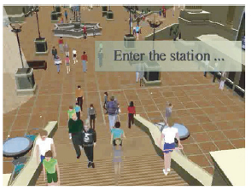
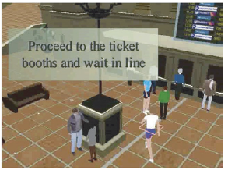
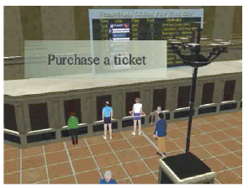
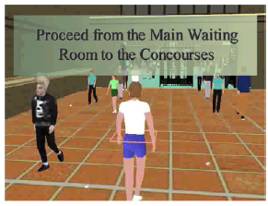
Following an Individual
Example of the behavior of a commuter in a trainstation (Courtesy [2]), which is a scenario closely related to a passenger who want to depart from an airfield.
[2] Shao & Terzopoulos, ‘Autonomous pedestrians’, Graphical Models, Volume 69, Issues 5–6, September–November 2007, Pages 246–274

Slide 5
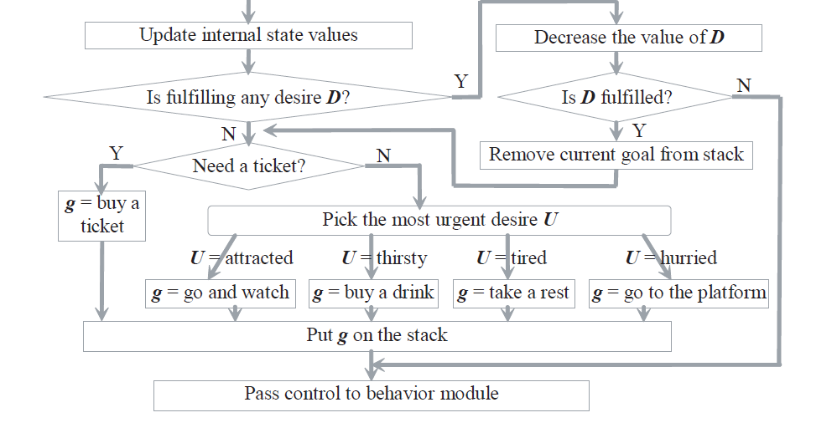
Behaviors triggered by desires
[2] Shao & Terzopoulos, ‘Autonomous pedestrians’, Graphical Models, Volume 69, Issues 5–6, September–November 2007, Pages 246–274

Slide 6
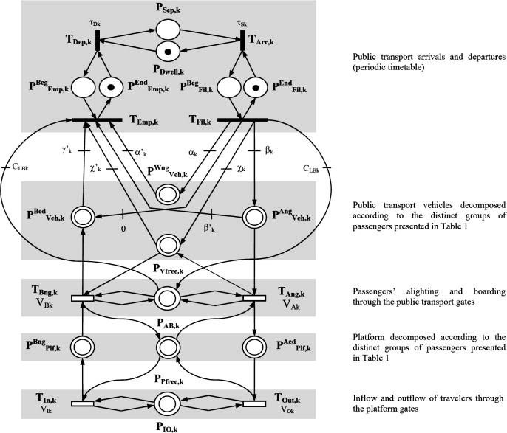
Deadline driven behavior
Example of a Petri net to specify time delays associated with transitions or places (Courtesy [3])
[3] Fateh Kaakaia et al., ‘A hybrid Petrinets-based simulation model for evaluating the design of railway transit stations’, Simulation Modelling Practice and Theory, Vol. 15, Issue 8, Sept. 2007, Pages 935–969.

Slide 7
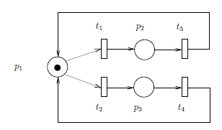

Petri-Net
Example of a ordinary Petri net, which models a state machine (Courtesy [4])
Where
P is the set of places; i.e. (p₁, …, p₃)
T is the set of transitions; i.e. (t₁, … t₄)
I is the set of input arcs; i.e. (p₁→ t₁, p₁→ t₂, p₂→ t₃, p₃→ t₄ )
O is the set of output arcs; i.e. (t₁ → p₂ , t₂ → p₃, t₃ → p₁, t₄ → p₁)
M₀ the initial marking (distribution of tokens); i.e. (p₁ )
[4] F. Bause & P.S. Kritzinger, ‘Stochastic Petri Nets - An Introduction to the Theory’, Friedr. Vieweg & Sohn Verlag, Braunschweig/Wiesbaden (Germany), Second Edition, 2002.

Slide 8
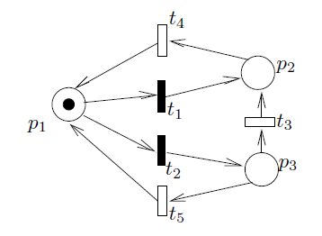
Generalized stochastic Petri net
Example of a generalized stochastic Petri net (Courtesy [4])
Where
T is the set of transitions; i.e. immediate transactions (t₁, t₂) and timed transactions (t₃, t_{4,} t₅)
Λ is the set of firing rates of time transactions; i.e. (0, 0, λ₃ , λ₄, λ ₅)
[4] F. Bause & P.S. Kritzinger, ‘Stochastic Petri Nets - An Introduction to the Theory’, Friedr. Vieweg & Sohn Verlag, Braunschweig/Wiesbaden (Germany), Second Edition, 2002.

Slide 9
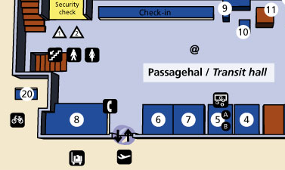
The situation
A typical transit hall of a regional airport, in this case Rotterdam Airport.

Slide 10
Typical Behavior
The default behavior is to check-in and go the security check.
Yet, alternative behaviors are observed, as waiting at the meeting point (10), buying things at the shops (4,5,7), smoking in the shelter (20), etc.

Slide 11
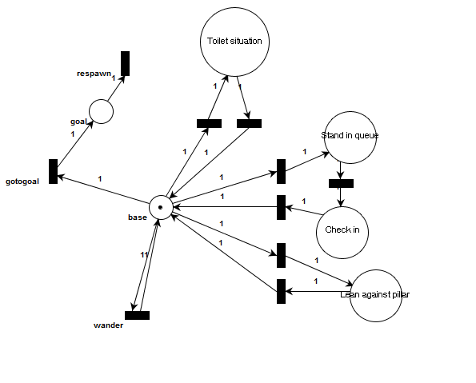
The model
Optimistic estimation: 4 timesteps
Optimistic estimation:
1 timestep
P(t)
Optimistic estimation: 2 timesteps
The default route through the Petri net is indicated in red.
All transitions are stochastic, which is a function of the time to departure (non-stationary Petri net).

Slide 12
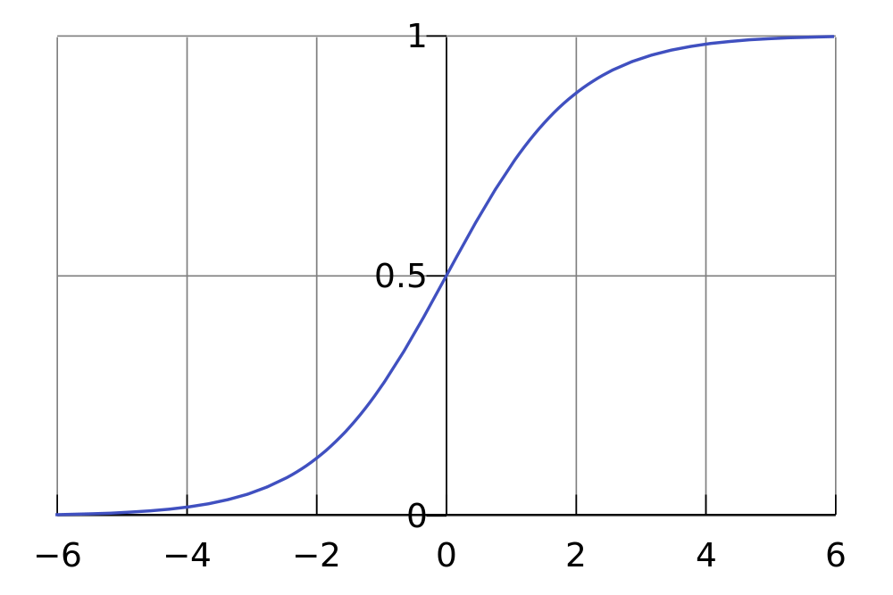
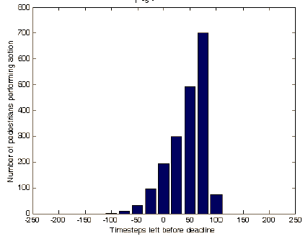
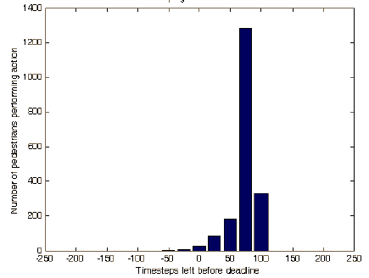
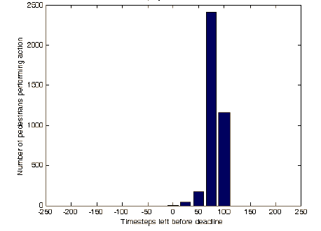
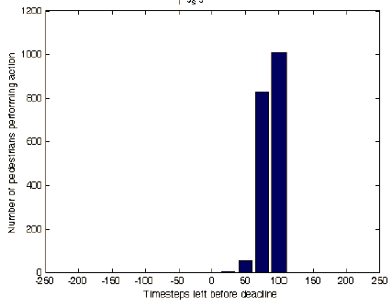
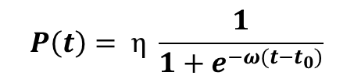
Variance on the Go-Goal behavior
$$P\left(t\right)= η \frac{1}{1+e^{−ω(t−t_{0})}}$$
Probability modeled with a Sigmoid function, for different values of η
For our experiments we chose $t_{0}=100$ and $ω=100$
η = 0.01
η = 0.1
η = 0.2
η = 0.5
For higher constant η the mean of the distribution shifts away from the deadline (the relative chance of directly going to goal is higher).

Slide 13
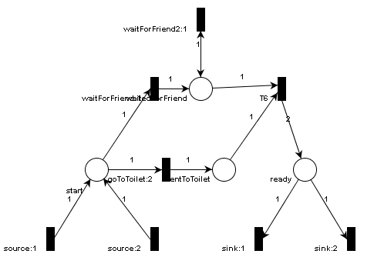
The Toilet situation
An often occurring situation is that person travel in pairs and that one person guards the luggage while the other goes to the toilet.

Slide 14
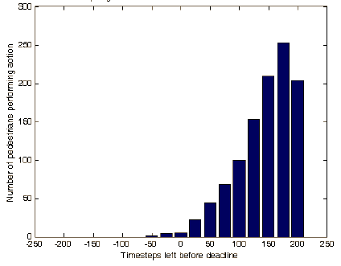
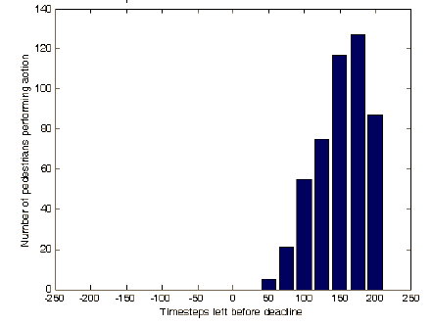
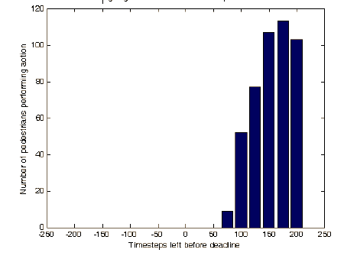
Variance in other behaviors
When the probability modeled of the Go-To-Goal behavior is varied with a Sigmoid function, the other behaviors are effected by normalization, as demonstrated for the Toilet situation.
η = 0.01
η = 0.1
η = 0.5
For a lower constant η other behaviors occur more often and the events can occur close to the deadline.

Slide 15
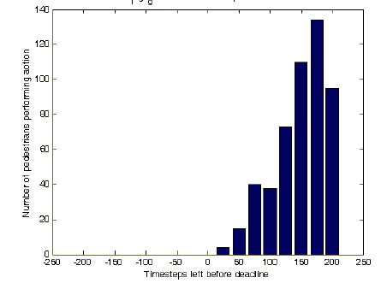
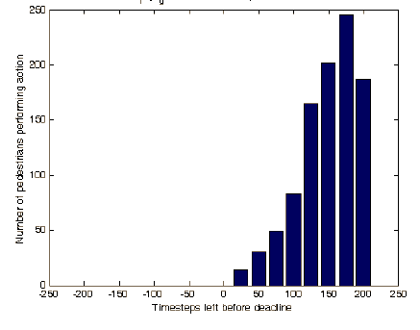
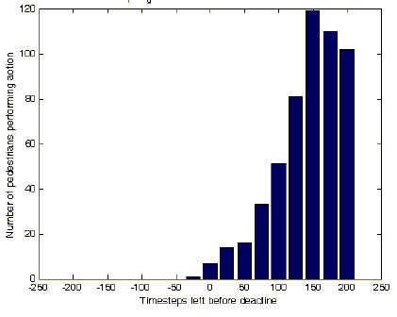

Time dependent behavior
$$P\left(t\right)= η e^{−ω(t−{t_{0})}^{2}}$$
Probability of the Go-To-Goal can also be modeled with a Gaussian function
For our experiments we chose a mean $t_{0}=200$ and a variance of $σ^{2}=100,$ which means $ω=50$.
η = 0.01
η = 0.2
η = 0.5
The effect on the other behaviors like the Toilet Situation is nearly equal.

Slide 16
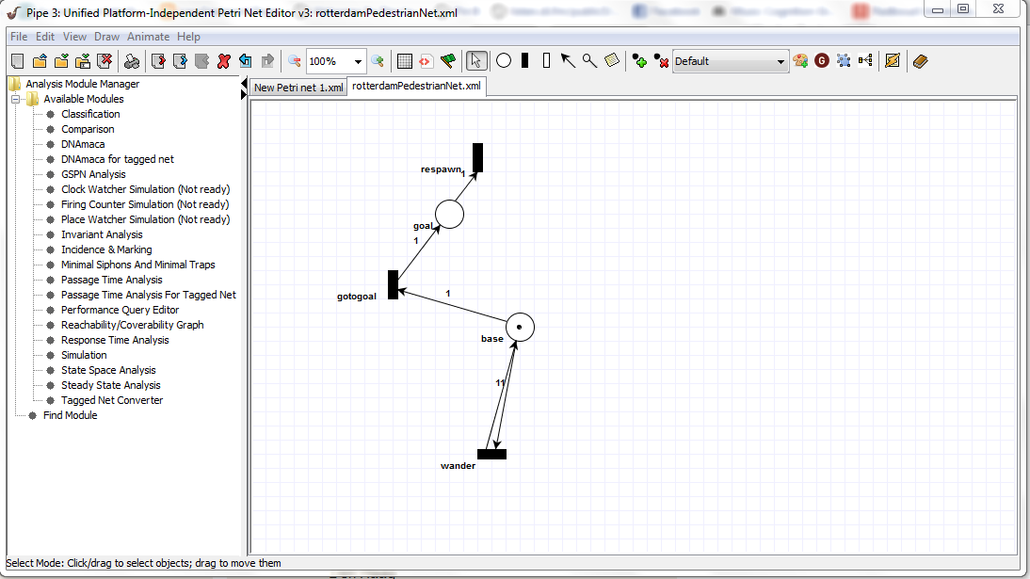
Evaluation structure
Petri nets are designed in java based editor (http://pipe2.sourceforge.net/ )

Slide 17
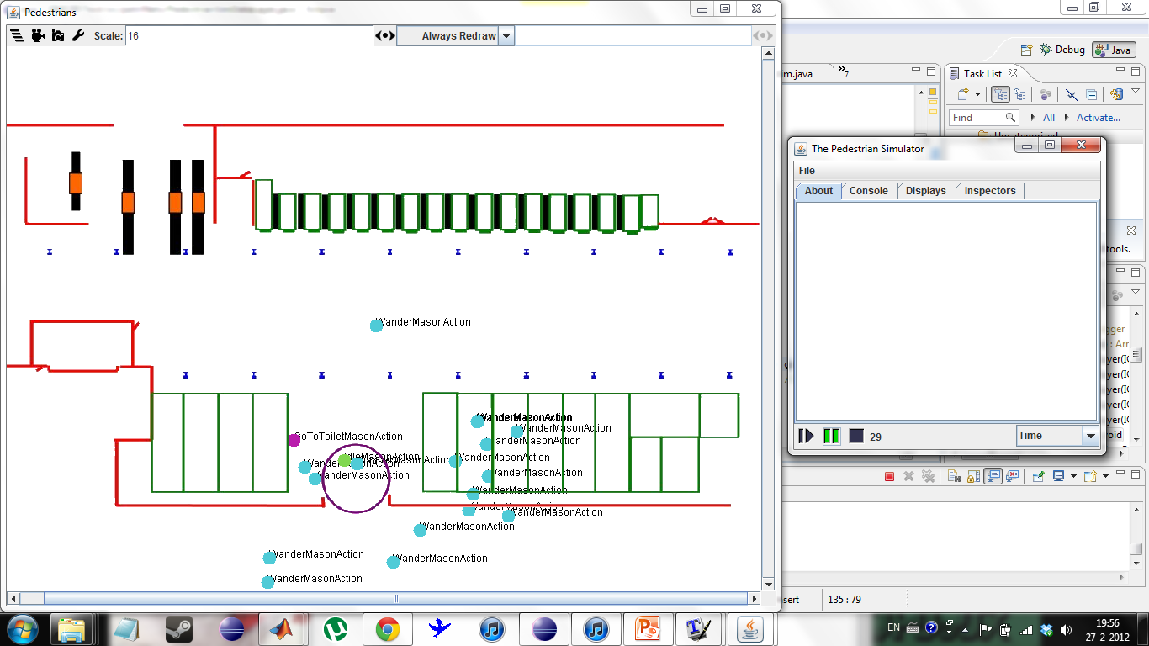
Integrated with multi agent framework
The simulation is based on MASON (http://cs.gmu.edu/~eclab/projects/mason/ )

Slide 18
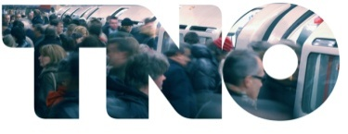
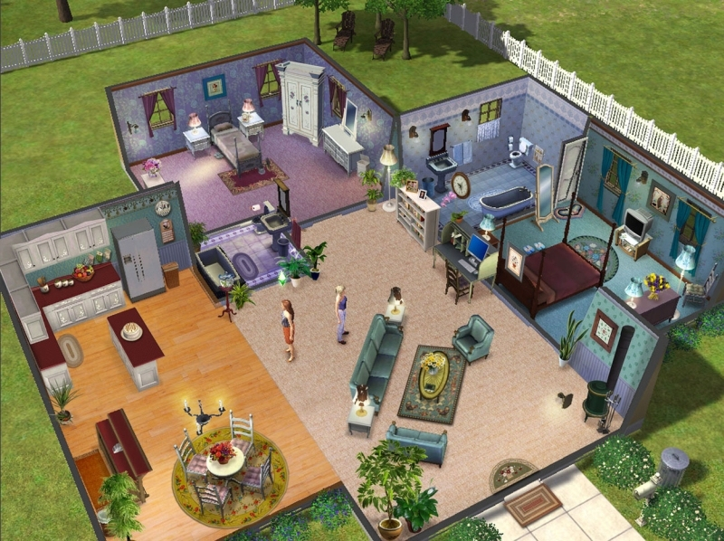
Conclusion
An innovative method to model pedestrian behavior is presented.
The probability to start a behavior is a function of time left.
This method can generate a rich set of behaviors.
Deadline driven behavior can be observed not only in transit halls, but in many daily routines (cooking, going to bed, etc).
Acknowledgement: The authors would like to thank Philip Kerbusch (TNO) for his input..

